Slide 1
Tree traversals

Slide 2
Outline
This topic will cover tree traversals:
A means of visiting all the objects in a tree data structure
We will look at
Breadth-first traversals
Depth-first traversals
Pre-order and Post-order depth-first traversals
Applications
General guidelines

Slide 3
Background
4.3
All the objects stored in an array or linked list can be accessed sequentially
When discussing deques, we introduced iterators in C++:
These allow the user to step through all the objects in a container
Question: how can we iterate through all the objects in a tree in a predictable and efficient manner
Requirements: Θ(n) run time and o(n) memory
Notes:
3

Slide 4
Types of Traversals
4.3.1
We have already seen one traversal:
The breadth-first traversal visits all nodes at depth k before proceeding onto depth k + 1
Easy to implement using a queue
Another approach is to visit always go as deep as possible before visiting other siblings: depth-first traversals

Slide 5
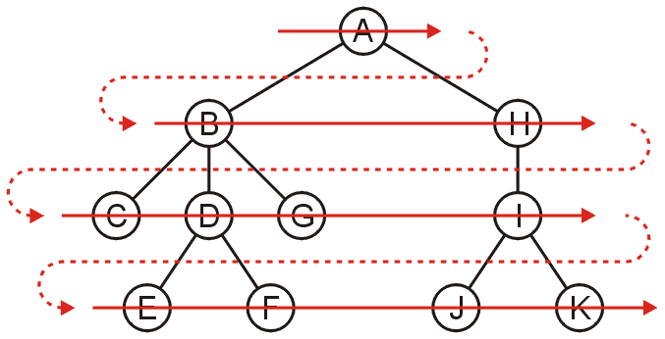
Breadth-First Traversal
4.3.1
Breadth-first traversals visit all nodes at a given depth
Can be implemented using a queue
Run time is Θ(n)
Memory is potentially expensive: maximum nodes at a given depth
Order: A B H C D G I E F J K

Slide 6
Breadth-First Traversal
4.3.1
The implementation was already discussed:
Create a queue and push the root node onto the queue
While the queue is not empty:
Push all of its children of the front node onto the queue
Pop the front node

Slide 7
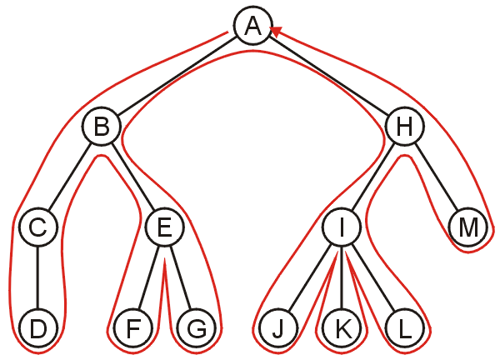
Backtracking
4.3.2
To discuss depth-first traversals, we will define a backtracking algorithm for stepping through a tree:
At any node, we proceed to the first child that has not yet been visited
Or, if we have visited all the children (of which a leaf node is a special case), we backtrack to the parent and repeat this decision making process
We end once all the children of the root are visited

Slide 8
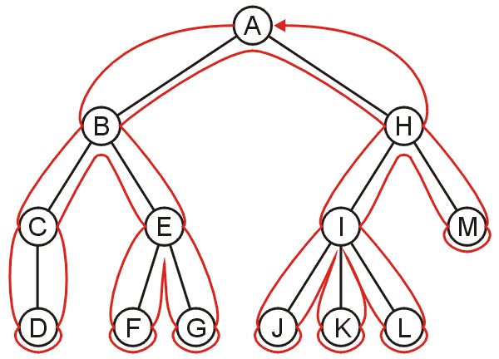
Depth-first Traversal
4.3.2
We define such a path as a depth-first traversal
We note that each node could be visited twice in such a scheme
The first time the node is approached (before any children)
The last time it is approached (after all children)

Slide 9
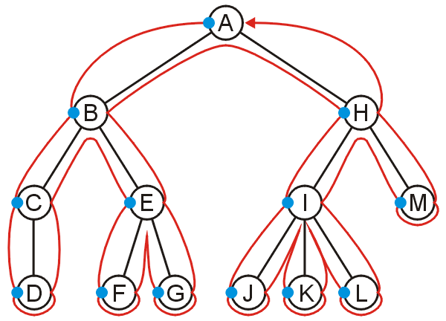
Pre-order Depth-first Traversal
4.3.2.1
Visiting each node first results in the sequence
A, B, C, D, E, F, G, H, I, J, K, L, M

Slide 10
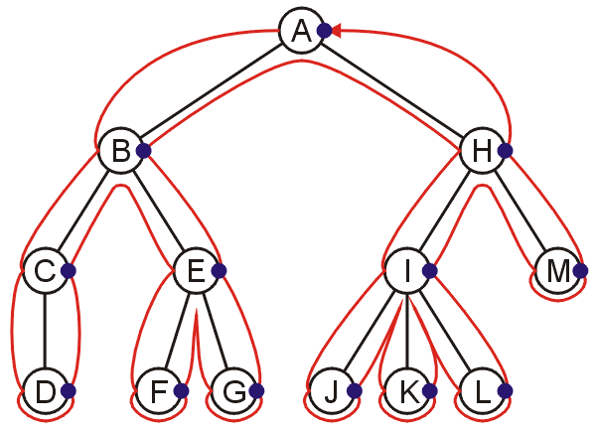
Post-order Depth-first Traversal
4.3.2.1
Visiting the nodes with their last visit:
D, C, F, G, E, B, J, K, L, I, M, H, A

Slide 11
Implementing Depth-First Traversals
4.3.3
Depth-first traversals can be implemented with recursion:
template <typename Type> void Simple_tree<Type>::depth_first_traversal() const {
// Perform pre-visit operations on the element
std::cout << element << ' ';
// Perform a depth-first traversal on each of the children
for (
ece250::Single_node<Simple_tree *> *ptr = children.head();
ptr != 0; ptr = ptr->next()
) {
ptr->retrieve()->depth_first_traversal();
}
// Perform post-visit operations on the element
std::cout << element << ' ';
}

Slide 12
Implementing Depth-First Traversals
4.3.3
Alternatively, we can use a stack:
Create a stack and push the root node onto the stack
While the stack is not empty:
Pop the top node
Push all of the children of that node to the top of the stack in reverse order
Run time is Θ(n)
The objects on the stack are all unvisited siblings from the root to the current node
If each node has a maximum of two children, the memory required is Θ(h): the height of the tree
With the recursive implementation, the memory is Θ(h): recursion just hides the memory
Notes:
12

Slide 13
Guidelines
4.3.4
Depth-first traversals are used whenever:
The parent needs information about all its children or descendants, or
The children require information about all its parent or ancestors
In designing a depth-first traversal, it is necessary to consider:
Before the children are traversed, what initializations, operations and calculations must be performed?
In recursively traversing the children:
What information must be passed to the children during the recursive call?
What information must the children pass back, and how must this information be collated?
Once all children have been traversed, what operations and calculations depend on information collated during the recursive traversals?
What information must be passed back to the parent?

Slide 14
Applications
4.3.4
Tree application: displaying information about directory structures and the files contained within
Finding the height of a tree
Printing a hierarchical structure
Determining memory usage

Slide 15
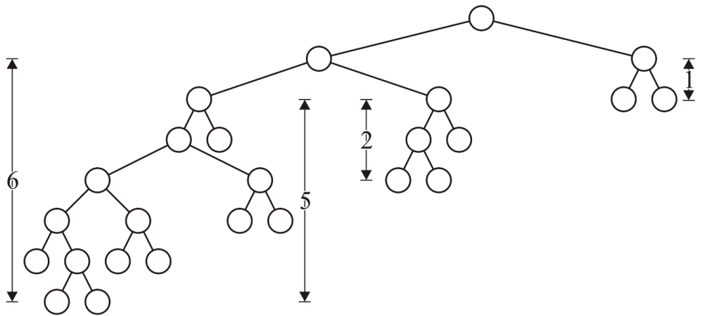
Height
4.3.4.1
The int height() const function is recursive in nature:
Before the children are traversed, we assume that the node has no children and we set the height to zero: h_{current} = 0
In recursively traversing the children, each child returns its height h and we update the height if 1 + h > h_{current}
Once all children have been traversed, we return h_{current}
When the root returns a value, that is the height of the tree

Slide 16
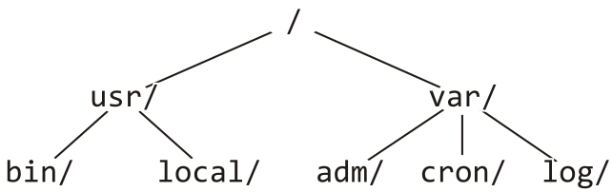
Printing a Hierarchy
4.3.4.2
Consider the directory structure presented on the left—how do we display this in the format on the right?
/
usr/
bin/
local/
var/
adm/
cron/
log/
What do we do at each step?

Slide 17
Printing a Hierarchy
4.3.4.2
For a directory, we initialize a tab level at the root to 0
We then do:
Before the children are traversed, we must:
Indent an appropriate number of tabs, and
Print the name of the directory followed by a '/'
In recursively traversing the children:
A value of one plus the current tab level must be passed to the children, and
No information must be passed back
Once all children have been traversed, we are finished

Slide 18
Printing a Hierarchy
4.3.4.2
Assume the function void print_tabs( int n ) prints n tabs
template <typename Type>
void Simple_tree<Type>::print( int depth ) const {
print_tabs( depth );
std::cout << retrieve()->name() << '/' << std::endl;
for (
ece250::Single_node<Simple_tree *> *ptr = children.head();
ptr != 0; ptr = ptr->next()
) {
ptr->retrieve()->print( depth + 1 );
}
}

Slide 19
Determining Memory Usage
4.3.4.3
Suppose we need to determine the memory usage of a directory and all its subdirectories:
We must determine and print the memory usage of all subdirectories before we can determine the memory usage of the current directory

Slide 20
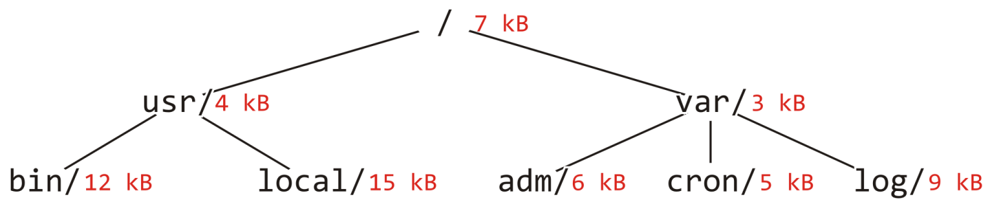
Determining Memory Usage
4.3.4.3
Suppose we are printing the directory usage of this tree:
bin/ 12
local/ 15
usr/ 31
adm/ 6
cron/ 5
log/ 9
var/ 23
/ 61

Slide 21
Determining Memory Usage
4.3.4.2
For a directory, we initialize a tab level at the root to 0
We then do:
Before the children are traversed, we must:
Initialize the memory usage to that in the current directory.
In recursively traversing the children:
A value of one plus the current tab level must be passed to the children, and
Each child will return the memory used within its directories and this must be added to the current memory usage.
Once all children have been traversed, we must:
Print the appropriate number of tabs,
Print the name of the directory followed by a "/ ", and
Print the memory used by this directory and its descendants

Slide 22
Printing a Hierarchy
4.3.4.3
template <typename Type>
int Simple_tree<Type>::du( int depth ) const {
int usage = retrieve()->memory();
for (
ece250::Single_node<Simple_tree *> *ptr = children.head();
ptr != 0; ptr = ptr->next()
) {
usage += ptr->retrieve()->du( depth + 1 );
}
print_tabs( depth );
std::cout << retrieve()->name() << "/ " << usage << std::endl;
return usage;
}

Slide 23
Summary
This topic covered two types of traversals:
Breadth-first traversals
Depth-first traversals
Applications
Determination of how to structure a depth-first traversal

Slide 24
References

Slide 25
Usage Notes
These slides are made publicly available on the web for anyone to use
If you choose to use them, or a part thereof, for a course at another institution, I ask only three things:
that you inform me that you are using the slides,
that you acknowledge my work, and
that you alert me of any mistakes which I made or changes which you make, and allow me the option of incorporating such changes (with an acknowledgment) in my set of slides
Sincerely,
Douglas Wilhelm Harder, MMath
dwharder@alumni.uwaterloo.ca

